Slide 1
GENERAL OPERATIONS BUDGET
ARTISAN LAKES COMMUNITY DEVELOPMENT DISTRICT

Slide 2
INTRODUCTIONS
District Manager – Vivian Carvalho & James Ward, PFM Management Services, LLC
District Legal Counsel – Jere Earlywine with Kutakrock
District Engineer – Atwell Engineering
District Board of Supervisors
  Peter Latessa – Chairman
  Tom Carpenter – Vice Chairperson
  Debbie Reynolds – Assistant Secretary
  Matt Moore – Assistant Secretary
  Kris Guillou – Assistant Secretary

Slide 3
BOARD STRUCTURE
Resident Elected Board of Supervisors
  The are five (5) seats on the Board, each elected for four (4) year terms.
  Elections are held in even numbered years, at the same time elected officials in the State are elected on the November ballot, which is the first Tuesday in November. Qualification in person by law is the third week of April of even numbered years before the November Election.
  Elections of Board Members are staggered – Three Members are up for election, then two years later two (2) members are up for election.
  In 2026, there are two (2) seats up for election, one person qualified to run for each seat.
  Qualification Requirements: A person who is a resident of the State, resides within the District and is registered to vote in Manatee County.

Slide 4
BUDGET TIMELINE AND BUDGET PROCESS
UPCOMING FISCAL YEAR – OCTOBER 1, 2026 THROUGH SEPTEMBER 30, 2027.
THE DISTRICT’S FISCAL YEAR IS SET BY STATE LAW.
THE PUBLIC HEARING DATE IS ALSO SET BY STATE LAW IN THE SUMMER MONTHS OF EACH YEAR.
BUDGET IS SUBMITTED TO THE BOARD OF SUPERVISOR’S IN THE FIRST QUARTER OF EACH YEAR, WHICH BEGINS THE REVIEW PROCESS. THIS COVERS THE OPERATIONS AND DEBT BUDGETS OF THE DISTRICT
THE DEBT SERVICE (CAPITAL ASSESSMENT AMOUNT) DOES NOT CHANGE ON YOUR TAX BILL.
MARCH-JULY - THE BOARD OF SUPERVISORS REVIEWS THE BUDGET AND THEN APPROVES THE PROPOSED BUDGET AND SETS A PUBLIC HEARING.
SEPTEMBER 11, 2025 IS PUBLIC HEARING DATE – BOARD MUST APPROVE THE BUDGET - ASSESSMENTS PLACED ON TAX BILLS THAT OWNERS WILL RECEIVE IN NOVEMBER, 2026

Slide 5
PUBLIC HEARING AGENDA FORMAT
BUDGET REVIEW : BOARD OF SUPERVISORS AND STAFF WILL REVIEW THE BUDGET FOR THE MEMBER OF THE PUBLIC AFTER WHICH THEIR WILL BE A PUBLIC COMMENT PERIOD.
PUBLIC COMMENT PERIOD;
  RESIDENTS ARE PROVIDED TIME TO ASK QUESTIONS RELATED TO THE BUDGET.
  WE ASK THAT RESIDENTS LIMIT TIME TO THREE (3) MINITUES FOR QUESTIONS TO ALLOW TIME FOR ALL MEMBERS TIME TO ASK QUESTIONS.
  PLEASE LIMIT QUESTIONS TO ONLY THE BUDGET – THE BOARD WILL ANSWER ALL OTHER QUESTIONS DURING THE PUBLIC COMMENT SECTION AT THE END OF THE AGENDA.
  PLEASE DIRECT ALL COMMENTS TO THE CHAIR/VICE CHAIR WHO WILL ASSIGN QUESTIONS TO THE APPROPRIATE PROFESSIONAL.
  PLEASE BE COURTEOUS AND PROFESSIONAL AT ALL TIMES.

Slide 6
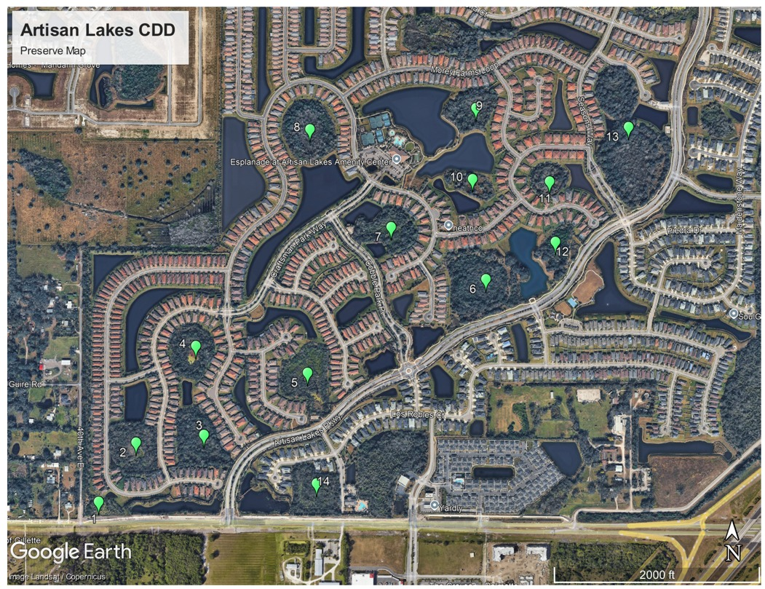
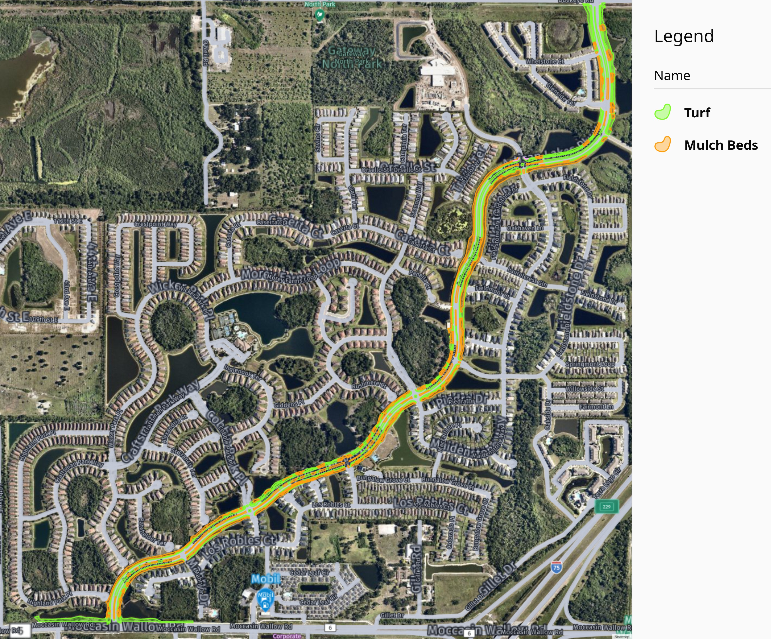
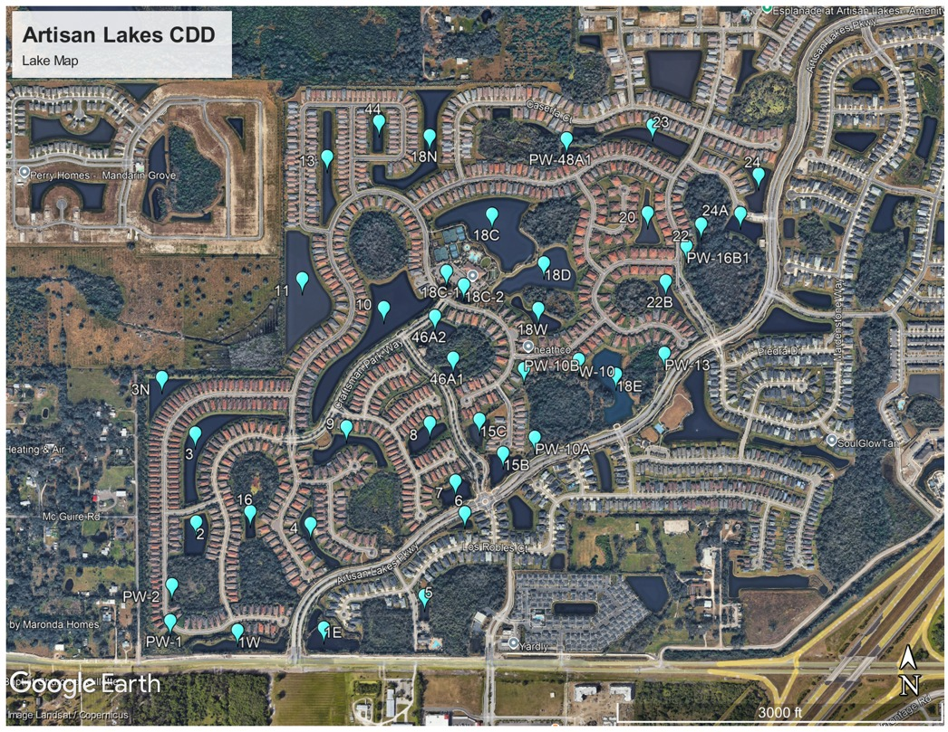
ARTISAN LAKES CDD MAPS
PRESERVES MAINTENANCE
LANDSCAPE – HOA MAINTAINED
LAKE MAINTENANCE

Slide 7
ARTISAN LAKES MAPS
DRAINAGE / STORMWATER MANAGEMENT EXHIBIT

Slide 8
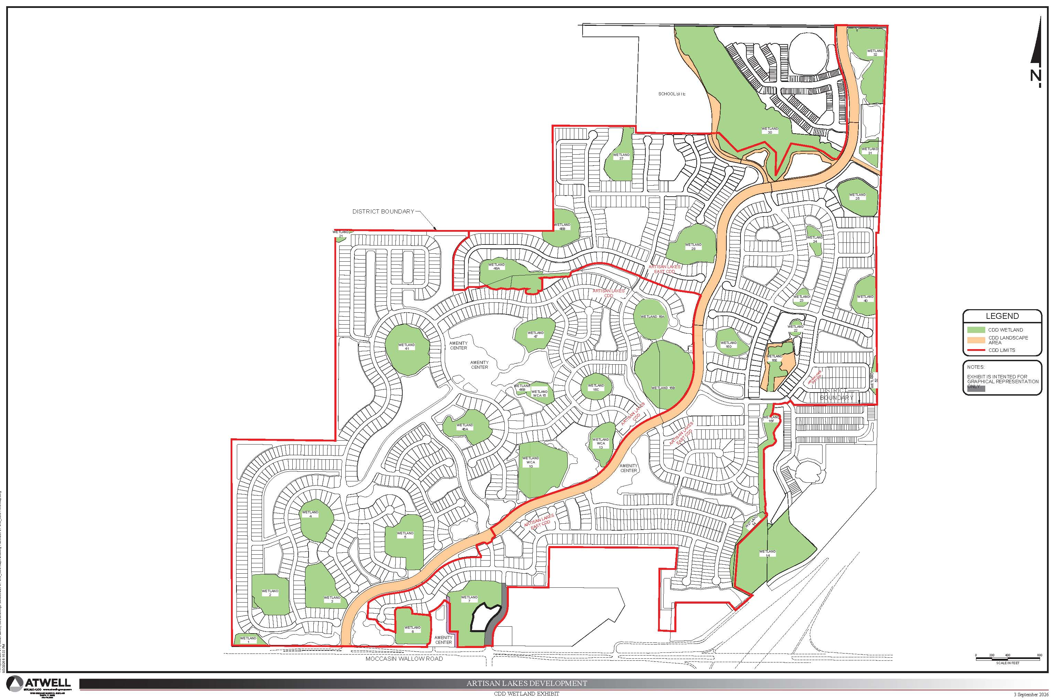
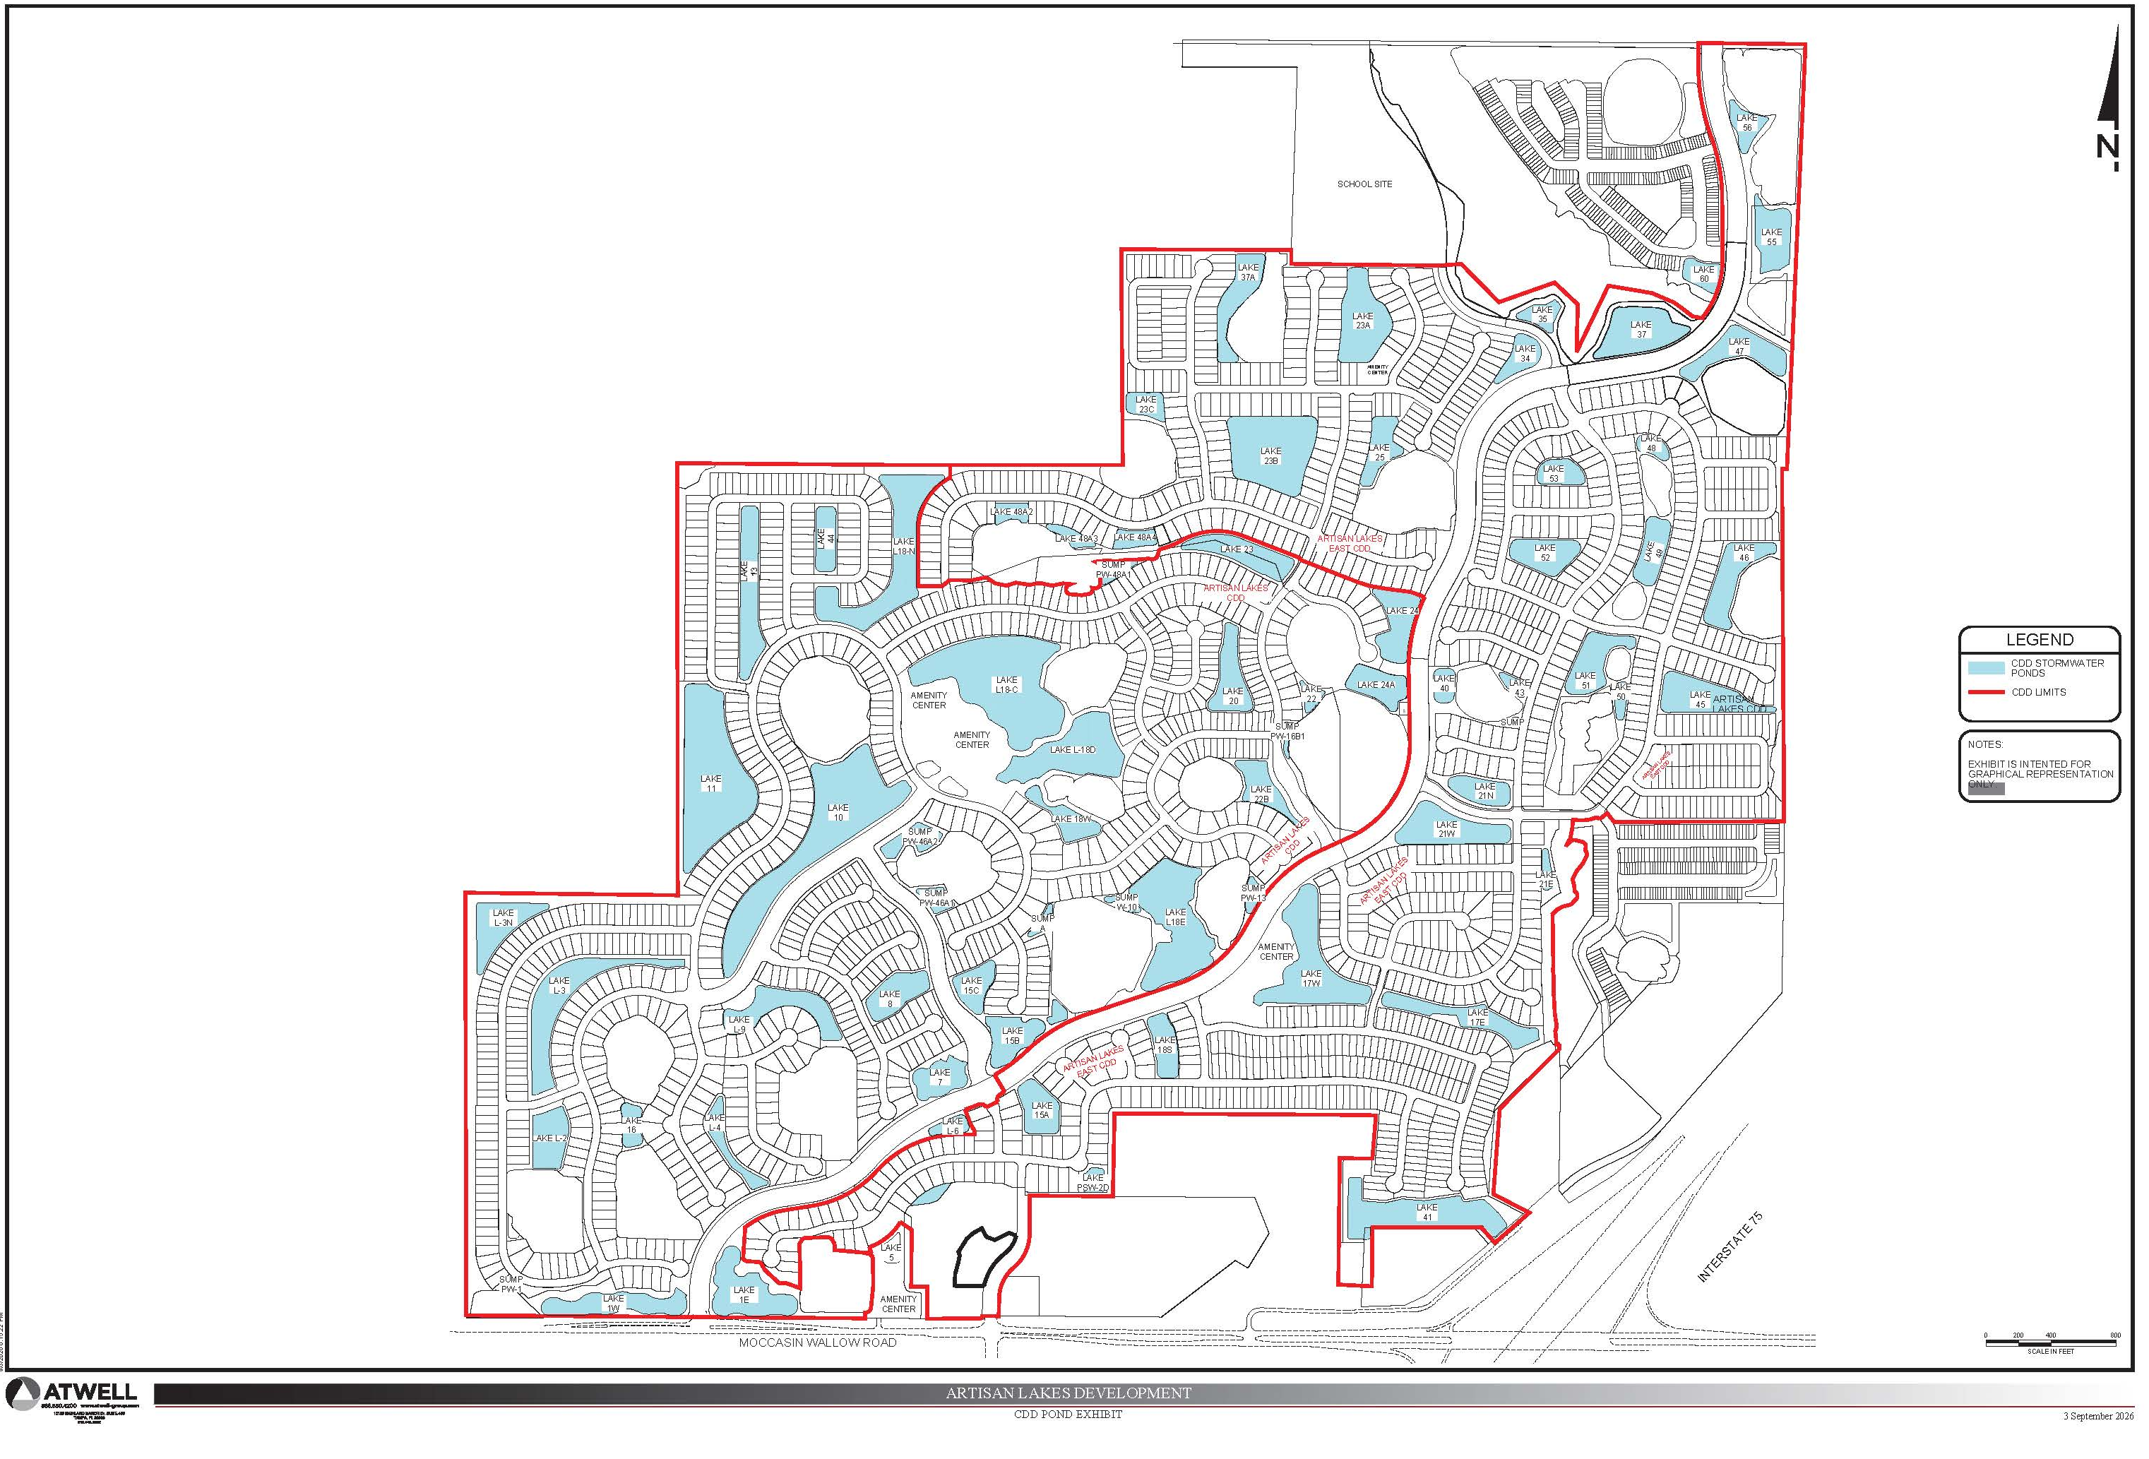
ARTISAN LAKES AND ARTISAN LAKES EAST CDD MAPS
PONDS
WETLANDS

Slide 9
CHALLENGES AND OPPORTUNITIES
CHALLENGES
OPPORTUNITIES
EVALUATING ASSETS IN FY 2027 TO PRESERVE AND ENHANCE THE LONG-TERM FUNCTIONALITY OF THE WATER MANAGEMENT SYSTEM.
INSURING CORRECT SCOPE OF SERVICES FOR MAINTENANCE.
INSURING COMPLIANCE WITH REGULATORY PERMITS.
DEFINING SERVICE LEVELS AS GROWTH OCCURS
DEVELOPMENT OF LONG TERM BUDGET PLAN.
STABILIZE ASSESSMENT RATE TO MINIMIZE INCREASES
INVESTING IN OUR COMMUNITIES SERVICE DELIVERY REQUIREMENTS TO MEET REGULATORY REQUIRMENTS AND COMMUNITY STANDARDS.

Slide 10
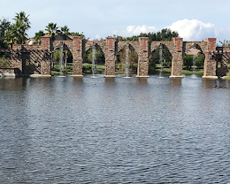
COMPONENTS OF BUDGET
GENERAL FUND
  PAYS FOR OPERATIONS, MAINTENANCE.
    STORMWATER MANAGEMENT SERVICES
      Asset Management – Aquatic Maintenance – Oversight, contractor coordination, inspections, reporting, and Board support.
      Aquatic Maintenance – Routine aquatic maintenance of 41 lakes consisting of approximately 52,096 linear feet and 68.13 acres.
      Littoral Shelf Plantings – Installation, enhancement, and replacement of littoral shelf plantings throughout the District.
      Lake Bank Maintenance – Repairs to shoreline erosion areas, bank stabilization, and re-sodding as needed.
      Midge Fly Treatments – Treatments performed on an as-needed basis throughout the District.
      Storm Drainage Inspections – Inspection of storm drainage structures, catch basins, control structures, outfalls, and associated infrastructure throughout the District.
    PRESERVE SERVICES
      Asset Management – Preserve Maintenance – Oversight, contractor coordination, inspections, reporting, and Board oversight and support.
      Preserve Maintenance – Quarterly maintenance of 14 preserve buffer areas, performed four (4) times per year.

Slide 11
Artisan Lakes CDD — Pond & Wetland Acreages
Stormwater Ponds | Total: 67.91 acres
Wetlands | Total: 62.85 acres
# | Acres | # | Acres | # | Acres
1E | 2.38 | 10 | 7.23 | 18C-2 | 0.17
1W | 1.73 | 11 | 6.95 | 18D | 4.12
PW1 | 0.12 | 13 | 2.20 | 18N | 4.06
PW2 | 0.10 | 15B | 1.39 | 20 | 1.42
2 | 1.86 | 15C | 0.78 | 22 | 0.10
3 | 3.29 | PW10A | 0.23 | 22B | 1.11
3N | 1.62 | PW10B | 0.28 | 23 | 1.90
4 | 1.06 | PW13 | 0.35 | 24 | 1.53
5 | 0.37 | PW16B1 | 0.39 | 24A | 1.27
6 | 0.30 | 18E | 3.39 | 44 | 0.88
7 | 1.15 | 18W | 1.31 | 46A-1 | 0.46
8 | 1.30 | 18C | 7.68 | 46A-2 | 1.11
9 | 1.85 | 18C-1 | 0.13 | PW-48A1 | 0.34
# | Acres
1 | 1.35
2 | 4.73
3 | 4.85
4 | 4.00
5 | 5.78
6 | 7.95
7 | 3.85
8 | 6.25
9 | 2.40
10 | 2.13
11 | 2.23
12 | 2.96
13 | 14.37

Slide 12
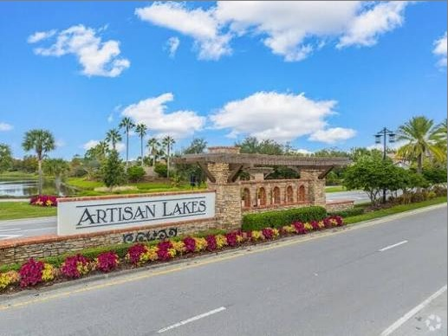
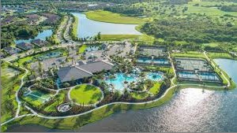
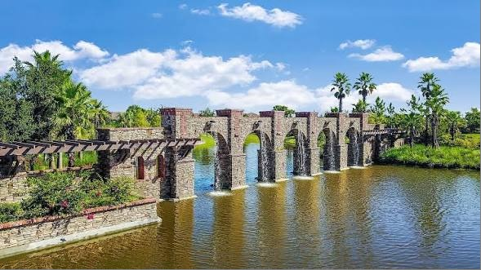
COMPONENTS OF BUDGET
GENERAL FUND
  CDD MAINTENANCE RESPONSIBILITIES
    Asset Management
    Midge Fly Treatments
    Lake Bank Restoration and Repairs
    Littoral Shelf Planting
    Aquatic Maintenance
    Stormwater Drainage Inspection
    Stormwater Drainage Cleaning
    Preserve Maintenance – Quarterly
  CDD-Owned Assets – Not Maintained
    Landscape Maintenance – Artisan Lakes Parkway

Slide 13
COMPONENTS OF BUDGET
DEBT SERVICE
  THIS PORTION OF THE BUDGET PAYS THE PRINCIPAL AND INTEREST ON LONG TERM BONDS THAT WERE ISSUED TO FINANCE PORTIONS OF THE INFRASTRUCTURE DURING DEVELOPMENT.
  INCLUDES:
    WATER/SEWER UTILITIES.
    WATER MANAGEMENT SYTEMS, WHICH IS THE LAKES, LAKE BANKS, LITTORAL PLANTS, DRAINAGE PIPES.
    COMMUNITY WIDE IRRIGATION SYSTEM
HOW DEBT SERVICE WORKS
  FIXED AMOUNT ON EACH PROPERTY OWNERS TAX BILL THIS IS IN ADDITION TO THE OPERATION AMT.
  AMOUNT VARIES BASED ON WHEN A DIFFERENT PART OF THE COMMUNITY WAS DEVELOPED, INTEREST RATE ON THE BONDS.
  ALL BONDS ARE 30 YEAR BONDS.
  BONDS CAN BE REFINANCED AFTER 10 YEAR CALL PERIOD.
  OWNERS MAY PREPAY PRINCIPAL.
  BONDS TRANFER TO NEW OWNER IF HOME IS SOLD BY LAW.

Slide 14

BUDGET SUMMARY OF OPERATIONS

Slide 15
Assessment Rate Comparison
Fiscal Year 2027
General Fund
Desc FY 2026 FY 2027 Dollar Chg Capital Assessment
SF - 30’ 177.38 468.29 291.91 $ 724.05
SF - 40’ 177.38 468.29 291.91 $ 708.80 - $1,177.09
SF - 50’ 177.38 468.29 291.91 $ 855.29 - $1,324.28
SF - 60’ 177.38 468.29 291.91 $1,063.19 - $1,531.48
SF - 70’ 177.38 468.29 291.91 $1,240.39 - $1,708.68

Slide 16
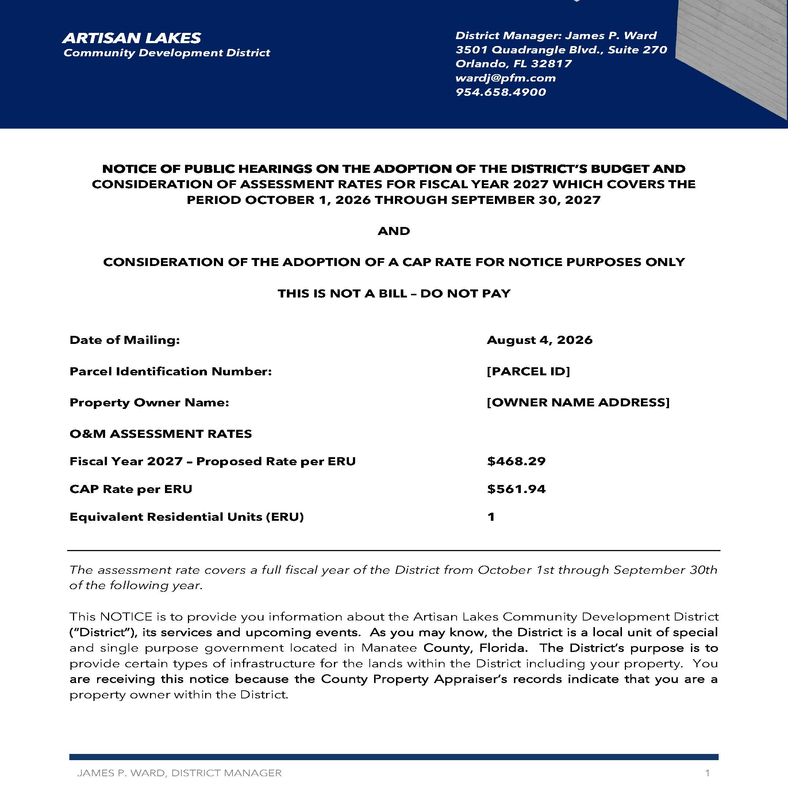
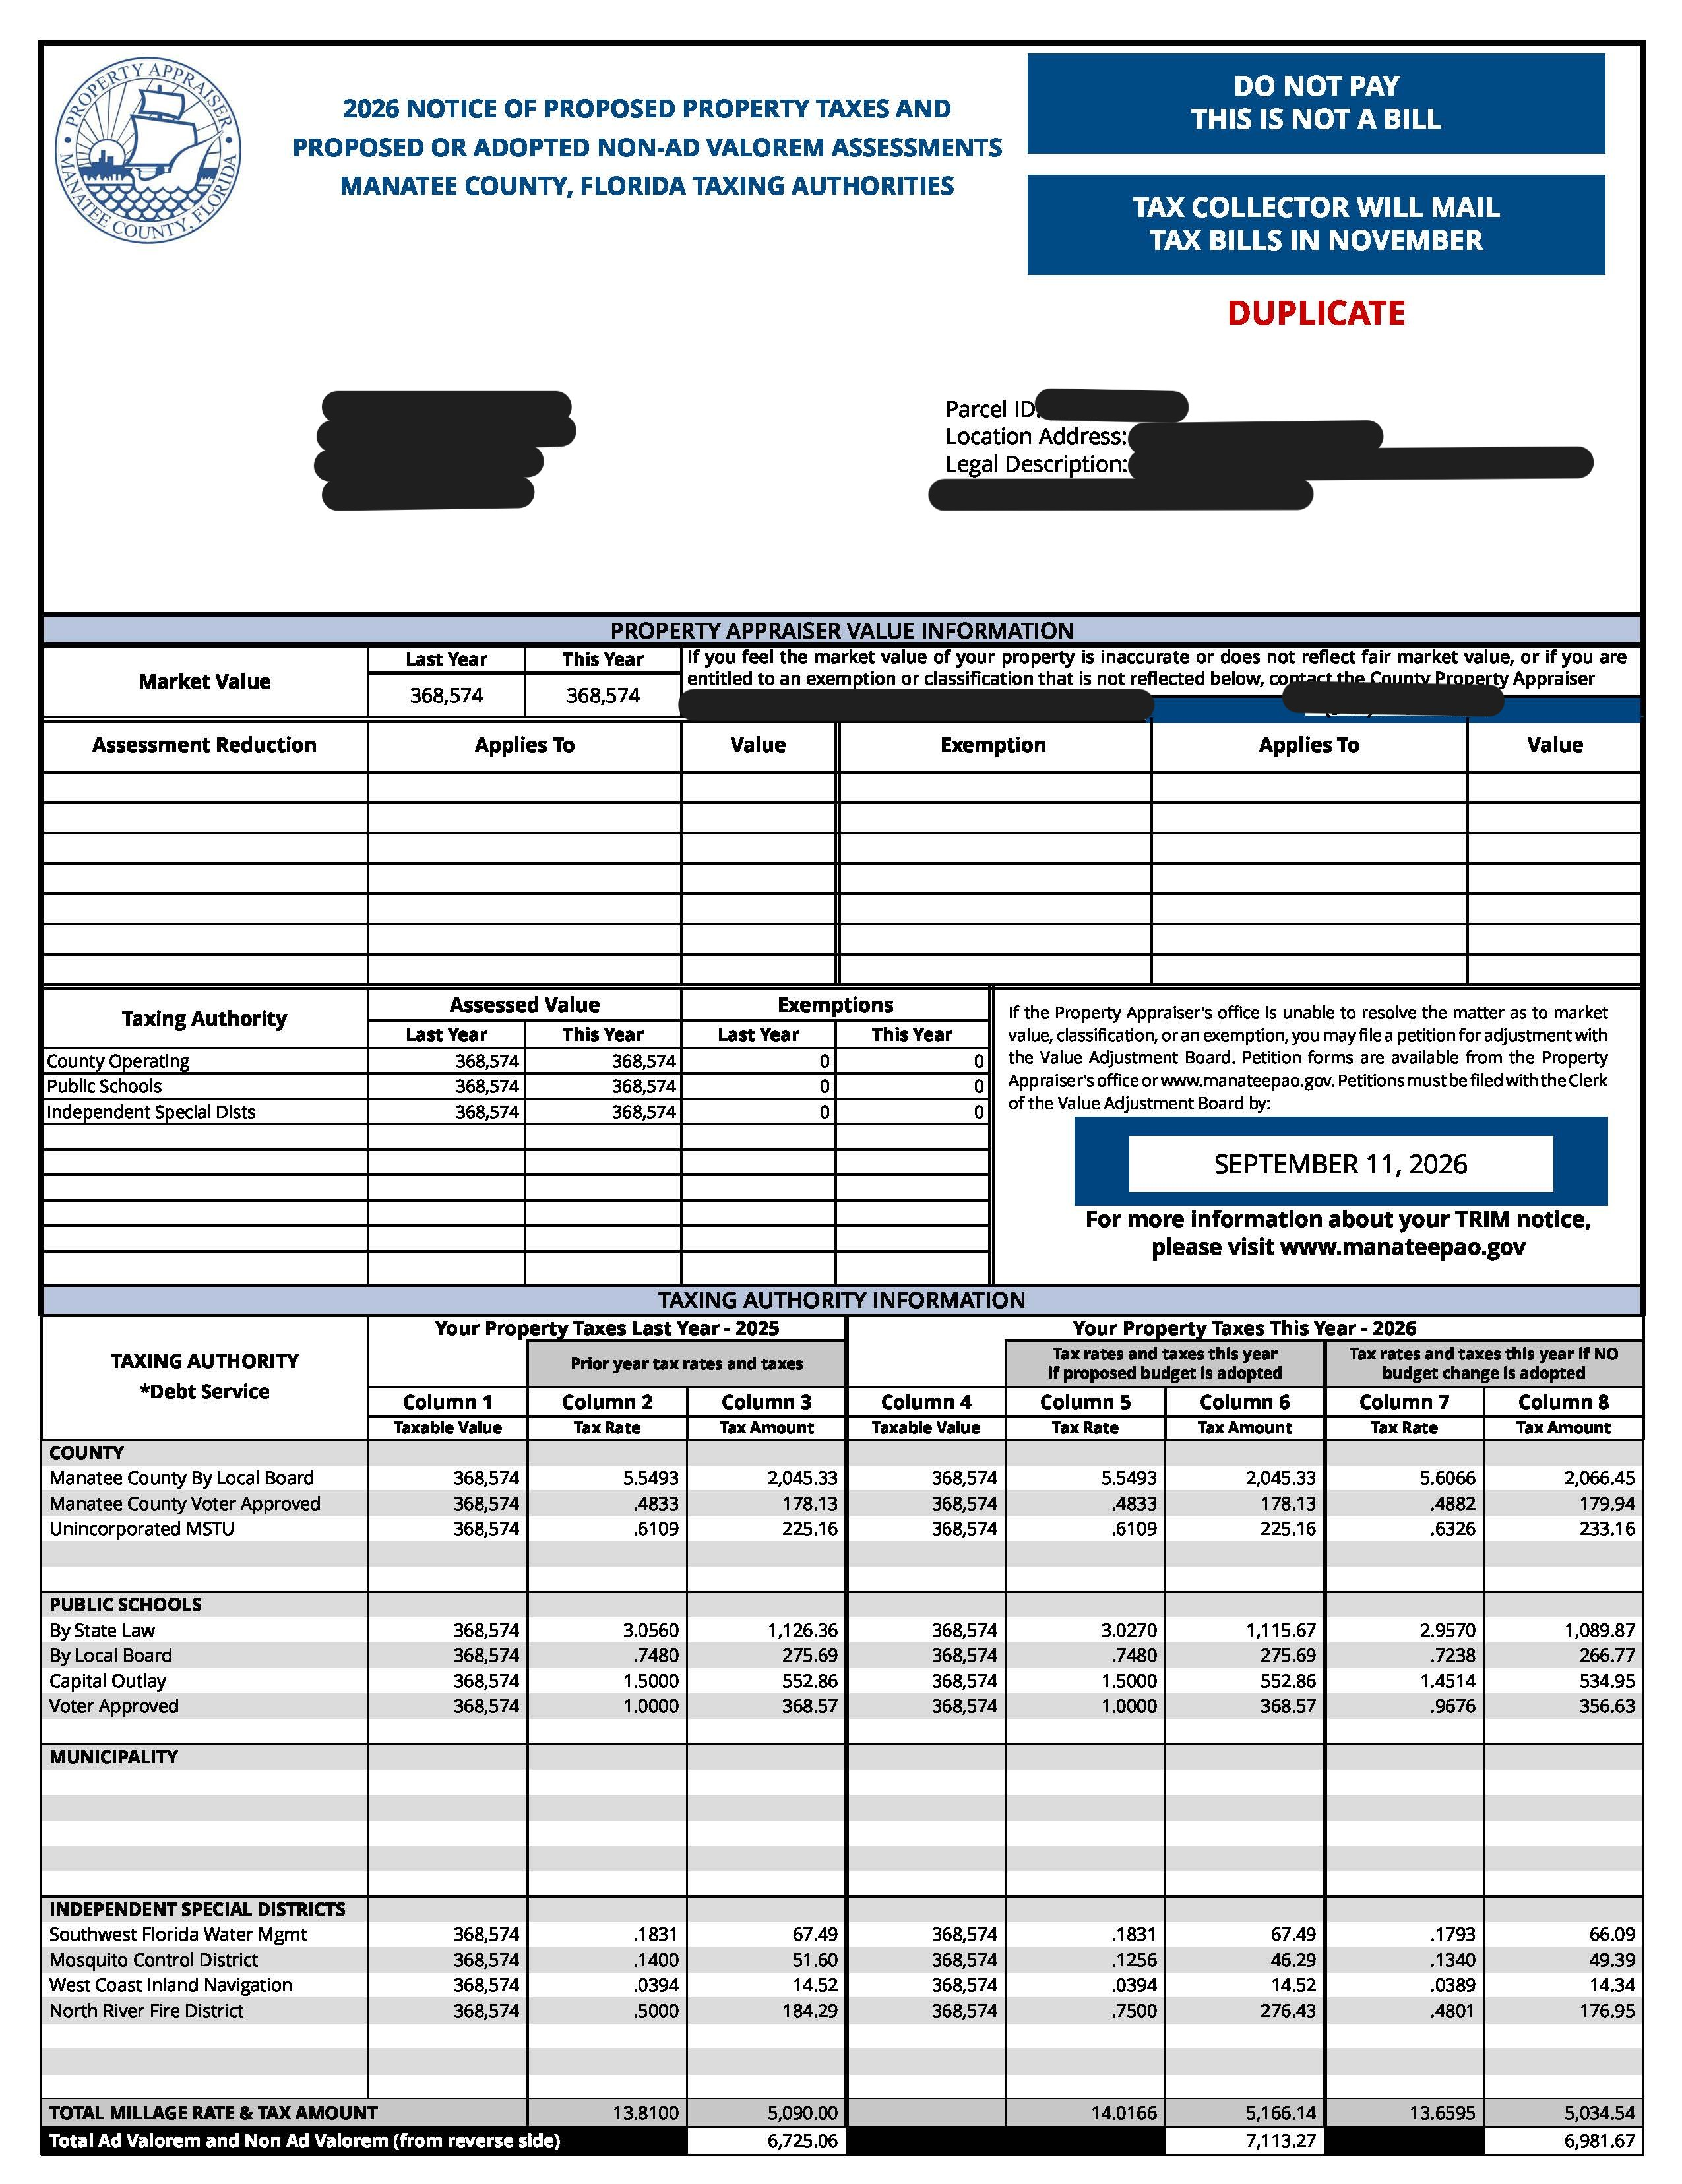
ARTISAN LAKES CDD COMPARISON OF MAILED NOTICE OF ASSESSMENTS AND MANATEE COUNTY TRIM NOTICE

Slide 17
ASSESSMENT RATE AND FINAL COMMENTS
THE CAP RATE IS $561.98
NO INCREASE ABOVE THE CAP RATE WITHOUT MAILED NOTICE TO ALL PROPERY OWNERS AND A PUBLIC HEARING.
PUBLIC HEARING EVERY YEAR TO ADOPT THE BUDGET & ASSESSMENT RATES.
PUBLIC HEARING PUBLISHED ON THE WEB SITE & IN NEWSPAPER WWW.ARTISANLAKESCDD.ORG THE DATE, TIME AND LOCATION.
DISTRICT WEB SITE – WWW.ARTISANLAKESCDD.ORG

