Slide 1
GENERAL OPERATIONS BUDGET
ARTISAN LAKES EAST COMMUNITY DEVELOPMENT DISTRICT

Slide 2
INTRODUCTIONS
District Manager – Vivian Carvalho & James Ward, PFM Management Services, LLC
District Legal Counsel – Jere Earlywine with Kutak Rock
District Engineer – Atwell Engineering
District Board of Supervisors
  Tina Golub – Chairman
  Michael Piendel – Vice Chairperson
  Matt Sawyer – Assistant Secretary
  Jim Schmidt – Assistant Secretary
  Eric Singer – Assistant Secretary

Slide 3
BOARD STRUCTURE
Resident Elected Board of Supervisors
  The are five (5) seats on the Board, each elected for four (4) year terms.
  Elections are held in even numbered years, at the same time elected officials in the State are elected on the ballot, the first Tuesday in November. Qualification person by law is in July of even numbered years.
  Elections of Board Members are staggered – Three Members are up for election, then two years later two (2) members are up for election.
  In 2026, there are two (2) seats up for election, only one person qualified to run for each seat.
  A person who is a resident of the State, resides within the District and is registered to vote in Manatee County may qualify to run for the Board.
  Replace 1 developer appointed seat with 1 qualified electors in Fall of 2028.

Slide 4
BUDGET TIMELINE AND BUDGET PROCESS
UPCOMING FISCAL YEAR – OCTOBER 1, 2026 THROUGH SEPTEMBER 30, 2027.
THE DISTRICT’S FISCAL YEAR IS SET BY STATE LAW
THE PUBLIC HEARING DATE IS ALSO SET BY STATE LAW IN THE SUMMER MONTHS OF EACH YEAR.
BUDGET IS SUBMITTED TO THE BOARD OF SUPERVISOR’S GENERALLY IN MARCH OF EACH YEAR, WHICH BEGINS THE REVIEW PROCESS. THIS COVERS THE OPERATIONS –
THE DEBT SERVICE DOES NOT CHANGE ON YOUR TAX BILL.
MARCH-JULY - THE BOARD OF SUPERVISORS REVIEWS THE BUDGET AND THEN APPROVES THE PROPOSED BUDGET AND SETS A PUBLIC HEARING.
PUBLIC HEARING DATE IS SET
SEPTEMBER XX, 2025 IS PUBLIC HEARING DATE – BOARD MUST APPROVE THE BUDGET - ASSESSMENTS PLACED ON TAX BILLS THAT OWNERS WILL RECEIVE IN NOVEMBER, 2026

Slide 5
TYPICAL PUBLIC HEARING AGENDA FORMAT
BUDGET REVIEW : BOARD OF SUPERVISORS AND STAFF
PUBLIC COMMENTS;
  RESIDENTS ARE PROVIDED TIME TO ASK QUESTIONS.
  WE ASK THAT RESIDENTS LIMIT TIME TO THREE (3) MINITUES TO ALLOW TIME FOR ALL MEMBERS TIME TO ASK QUESTIONS.
  PLEASE LIMIT QUESTIONS TO ONLY THE BUDGET – THE BOARD WILL ANSWER ALL OTHER QUESTIONS DURING THE PUBLIC COMMENT SECTION AT THE END OF THE AGENDA.
  PLEASE DIRECT ALL COMMENTS TO THE CHAIR/VICE CHAIR WHO WILL ASSIGN QUESTIONS TO THE APPROPRIATE PROFESSIONAL.
  PLEASE BE COURTEOUS AND PROFESSIONAL

Slide 6
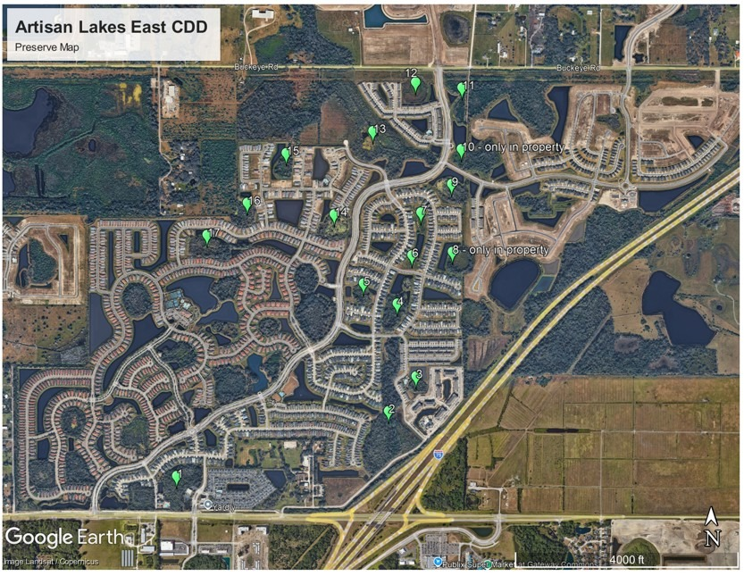
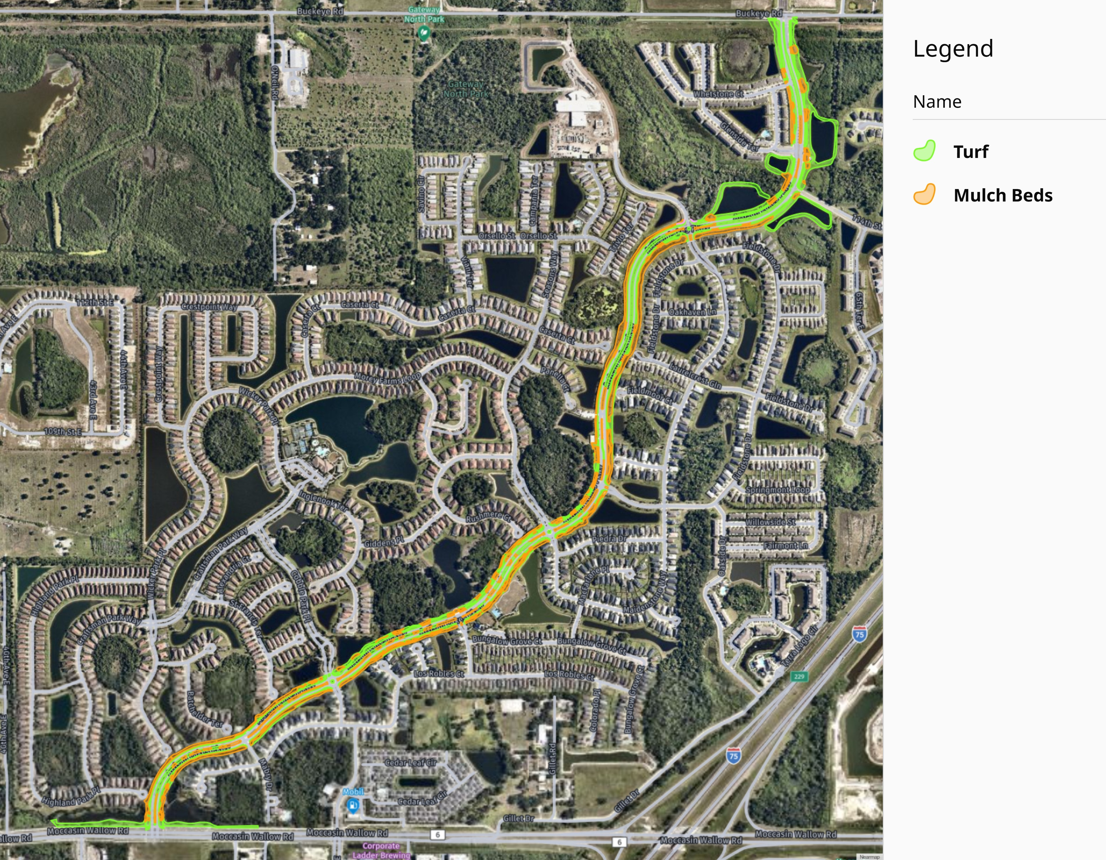
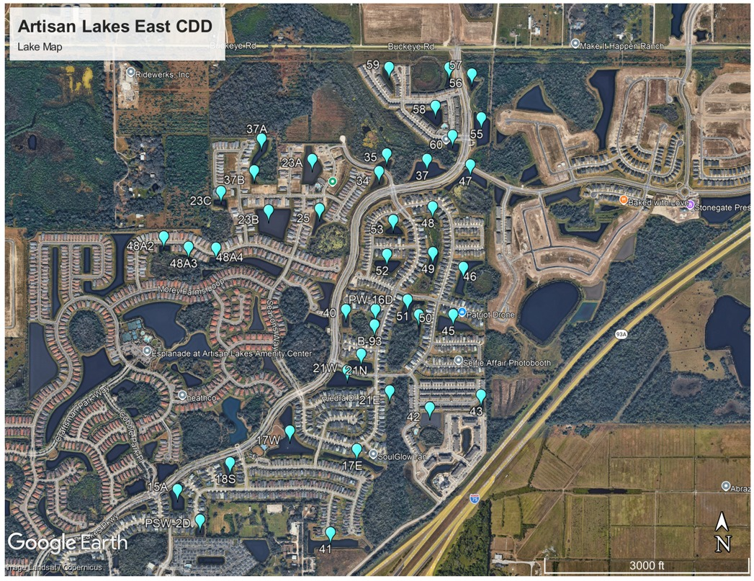
ARTISAN LAKES EAST CDD MAPS
PRESERVES MAINTENANCE
LANDSCAPE – HOA MAINTAINED
LAKE MAINTENANCE

Slide 7
ARTISAN LAKES EAST MAPS
DRAINAGE / STORMWATER MANAGEMENT EXHIBIT
SHEET 1
SHEET 2

Slide 8
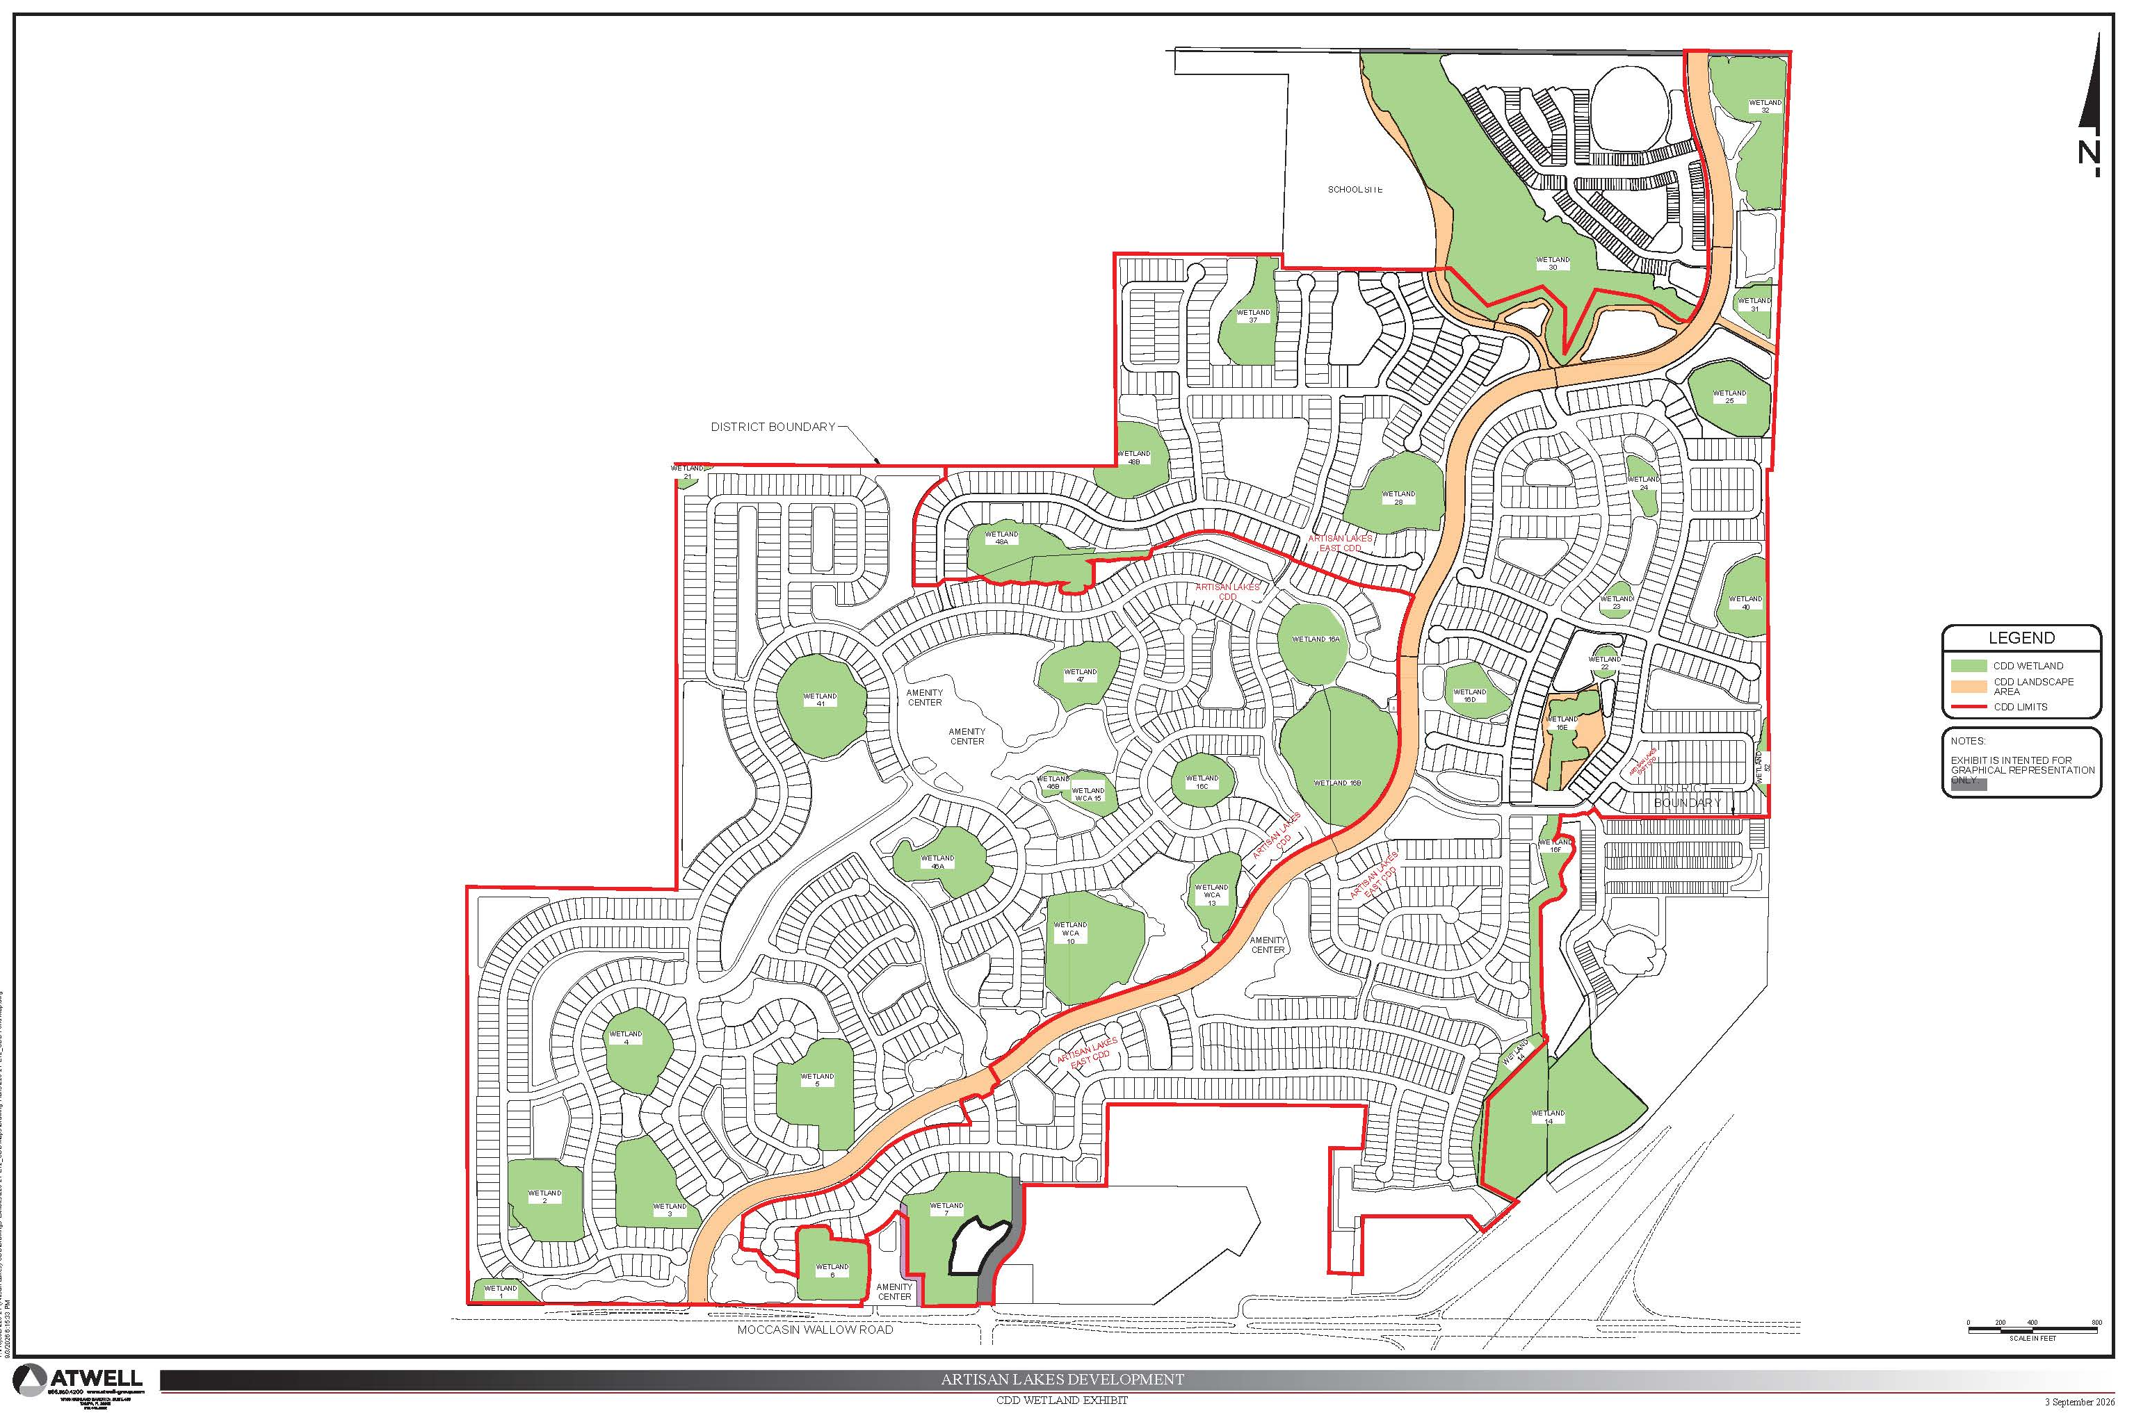
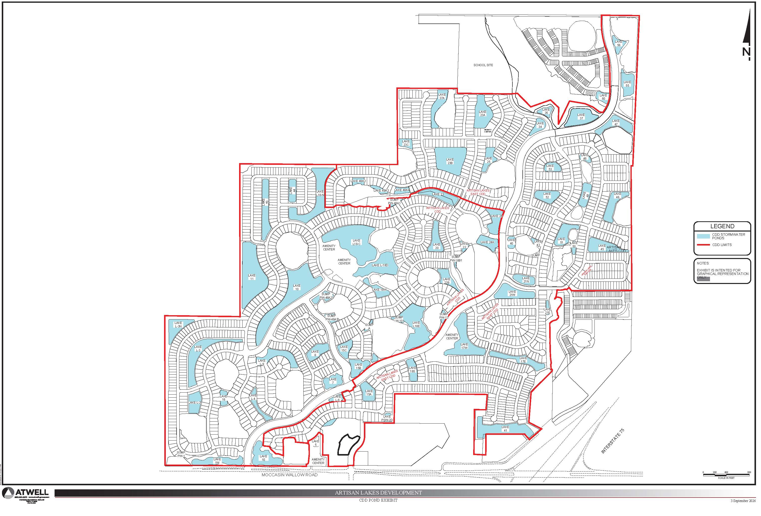
ARTISAN LAKES EAST AND ARTISAN LAKES CDD MAPS
PONDS
WETLANDS

Slide 9
CHALLENGES AND OPPORTUNITIES
CHALLENGES
OPPORTUNITIES
EVALUATING ASSESTS IN FY 2027 TO PRESERVE AND ENHANCE THE LONG-TERM FUNCTIONALITY OF THE WATER MANAGEMENT SYSTEM.
INSURING CORRECT SCOPE OF SERVICES FOR MAINTENANCE.
INSURING COMPLIANCE WITH REGULATORY PERMITS.
DEFINING SERVICE LEVELS AS GROWTH OCCURS
DEVELOPMENT OF LONG TERM BUDGET PLAN.
STABILIZE ASSESSMENT RATE TO MINIMIZE INCREASES
INVESTING IN OUR COMMUNITIES SERVICE DELIVERY REQUIREMENTS TO MEET REGULATORY REQUIRMENTS AND COMMUNITY STANDARDS.

Slide 10
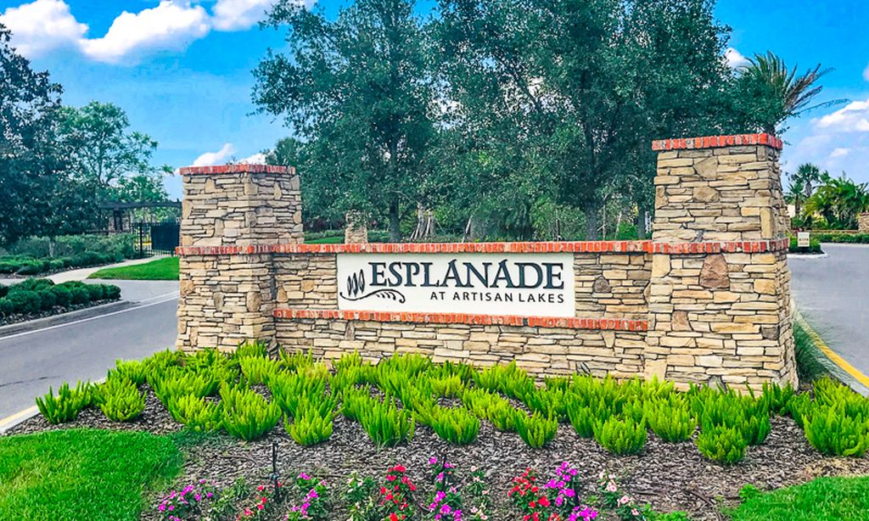
COMPONENTS OF BUDGET
GENERAL FUND
  PAYS FOR OPERATIONS, MAINTENANCE.
    STORMWATER MANAGEMENT SERVICES
      Asset Management – Aquatic Maintenance – Oversight, contractor coordination, inspections, reporting, and Board support.
      Aquatic Maintenance – Routine aquatic maintenance of 41 lakes consisting of approximately 40,780 linear feet and 44.67 acres.
      Littoral Shelf Plantings – Installation, enhancement, and replacement of littoral shelf plantings throughout the District.
      Lake Bank Maintenance – Repairs to shoreline erosion areas, bank stabilization, and re-sodding as needed.
      Midge Fly Treatments – Treatments performed on an as-needed basis throughout the District.
      Storm Drainage Inspections – Inspection of storm drainage structures, catch basins, control structures, outfalls, and associated infrastructure throughout the District.
    PRESERVE SERVICES
      Asset Management – Preserve Maintenance – Oversight, contractor coordination, inspections, reporting, and Board support.
      Preserve Maintenance – Quarterly maintenance of 17 preserve buffer areas, performed four (4) times per year.

Slide 11
Artisan Lakes East CDD — Pond & Wetland Acreages
Stormwater Ponds | Total: 45.02 acres
Wetlands | Total: 102.21 acres
# | Acres | # | Acres | # | Acres
15A | 1.20 | 37A | 1.06 | 50 | 0.25
17W | 3.75 | 37B | 0.15 | 51 | 1.44
17E | 1.36 | 40 | 0.48 | 52 | 1.36
18S | 0.85 | 41 | 3.10 | 53 | 0.68
21W | 2.28 | 42 | 1.36 | 55 | 2.08
21N | 0.90 | 43 | 0.36 | 56 | 0.42
21E | 0.20 | 45 | 1.94 | 57 | 0.47
23A | 2.34 | 46 | 1.55 | 58 | 1.20
23B | 4.10 | 47 | 1.45 | 59 | 0.39
23C | 0.40 | 48 | 0.32 | 60 | 0.54
25 | 0.82 | 48A-2 | 0.34 | PW-16D | 0.48
34 | 0.57 | 48A-3 | 0.19 | B-93 | 0.06
35 | 0.39 | 48A-4 | 0.40 | PSW-2D | 0.43
37 | 2.27 | 49 | 1.09
# | Acres
1 | 7.76
2 | 19.10
3 | 1.51
4 | 3.76
5 | 1.97
6 | 0.79
7 | 1.09
8 | 2.90
9 | 4.19
10 | 1.90
11 | 5.50
12 | 5.06
13 | 28.70
14 | 5.52
15 | 2.75
16 | 3.46
17 | 6.25
Source: Artisan Lakes East CDD stormwater acreages (2026)

Slide 12
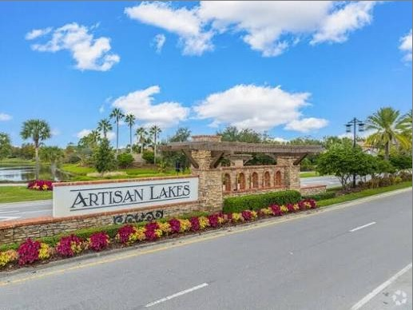
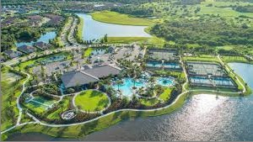
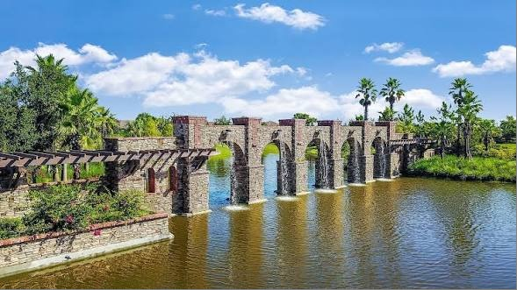
COMPONENTS OF BUDGET
GENERAL FUND
  CDD MAINTENANCE RESPONSIBILITIES
    Asset Management
    Midge Fly Treatments
    Lake Bank Restoration and Repairs
    Littoral Shelf Planting
    Aquatic Maintenance
    Stormwater Drainage
    Stormwater Drainage Cleaning
    Preserve Maintenance – Quarterly
  CDD-Owned Assets – Not Maintained
    Landscape Maintenance – Artisan Lakes Parkway

Slide 13
COMPONENTS OF BUDGET
DEBT SERVICE
  THIS PORTION OF THE BUDGET PAYS THE PRINCIPAL AND INTEREST ON LONG TERM BONDS THAT WERE ISSUED TO FINANCE PORTIONS OF THE INFRASTRUCTURE DURING DEVELOPMENT.
  INCLUDES:
    WATER/SEWER UTILITIES.
    WATER MANAGEMENT SYTEMS, WHICH IS THE LAKES, LAKE BANKS, LITTORAL PLANTS, DRAINAGE PIPES.
    COMMUNITY WIDE IRRIGATION SYSTEM
HOW DEBT SERVICE WORKS
  FIXED AMOUNT ON EACH PROPERTY OWNERS TAX BILL THIS IS IN ADDITION TO THE OPERATION AMT.
  AMOUNT VARIES BASED ON WHEN A DIFFERENT PART OF THE COMMUNITY WAS DEVELOPED, INTEREST RATE ON THE BONDS.
  ALL BONDS ARE 30 YEAR BONDS.
  BONDS CAN BE REFINANCED AFTER 10 YEAR CALL PERIOD.
  OWNERS MAY PREPAY PRINCIPAL.
  BONDS TRANFER TO NEW OWNER IF HOME IS SOLD BY LAW.

Slide 14

BUDGET SUMMARY OF OPERATIONS
Description |  |  |  |  |  | FYE 9/30/2026 Budget | FYE 9/30/2027 Budget | Variance
Revenues and Other Sources
 |  | Assessments - On-Roll |  |  |  | $ 155,792 | $ 386,581 | $ 230,789
 |  |  |  | Total Revenue & Other Sources |  | $ 155,792 | $ 386,581 | $ 230,789
Appropriations
 |  | Administrative Costs |  |  | # | $ 94,887 | $ 105,491 | $ 10,604
 |  | Operations & Maintenance |  |  | # | $ - | $ 205,800 | $ 205,800
 |  | Extraordinary Capital/Operations |  |  |  | $ 50,000 | $ 50,000 | $ -
 |  | Discounts, Tax Collector Fee and Property Appraiser Fee |  |  |  | $ 10,905 | $ 25,290 | $ 14,385
 |  |  |  | Total Appropriations | # | $ 155,792 | $ 386,581 | $ 230,789
Description |  |  |  |  |  | Assessment Rate Comparison
 |  |  |  |  |  | FYE 2026 | FYE 2027 | Variance
 |  | Assessment Rate - Administrative Costs Per Unit |  |  |  | $ 147.67 | $ 157.70 | $ 10.03
 |  | Assessment Rate - Operations & Maintenance Costs Per Unit |  |  |  | $ - | $ 208.73 | $ 208.73
 |  | Total Assessment Rate |  |  |  | $ 147.67 | $ 366.43 | $ 218.76
 |  | Total Units Subject to Assessment |  |  |  | 1,055 | 1,055 | 0
 |  | Fiscal Year 2026 Adopted Cap Rate |  |  |  | $ 148.47
 |  | Fiscal Year 2027 Proposed Cap Rate |  |  |  |  | $ 439.71 | $ 291.24

Slide 15
Assessment Rate Comparison
Fiscal Year 2027
General Fund
Desc FY 2026 FY 2027 Dollar Chg Capital Assessment
SF - 40’ 147.67 366.43 218.76 $ 848.98 - $1,064.12
SF - 50’ 147.67 366.43 218.76 $ 1,061.22 - $1,330.14
SF - 60’ 147.67 366.43 218.76 $1,273.46 - $1,596.17

Slide 16
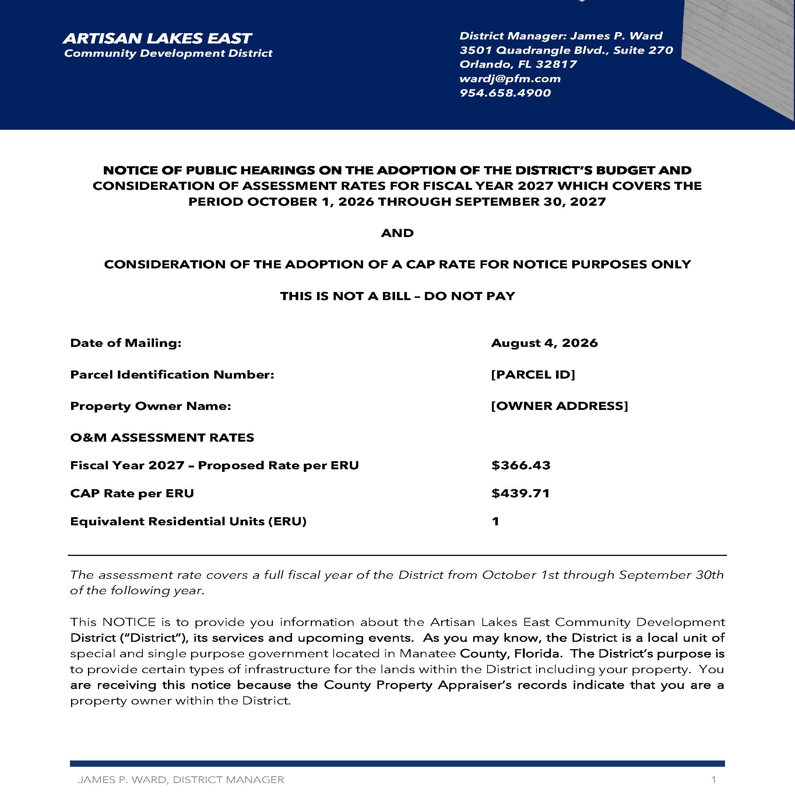
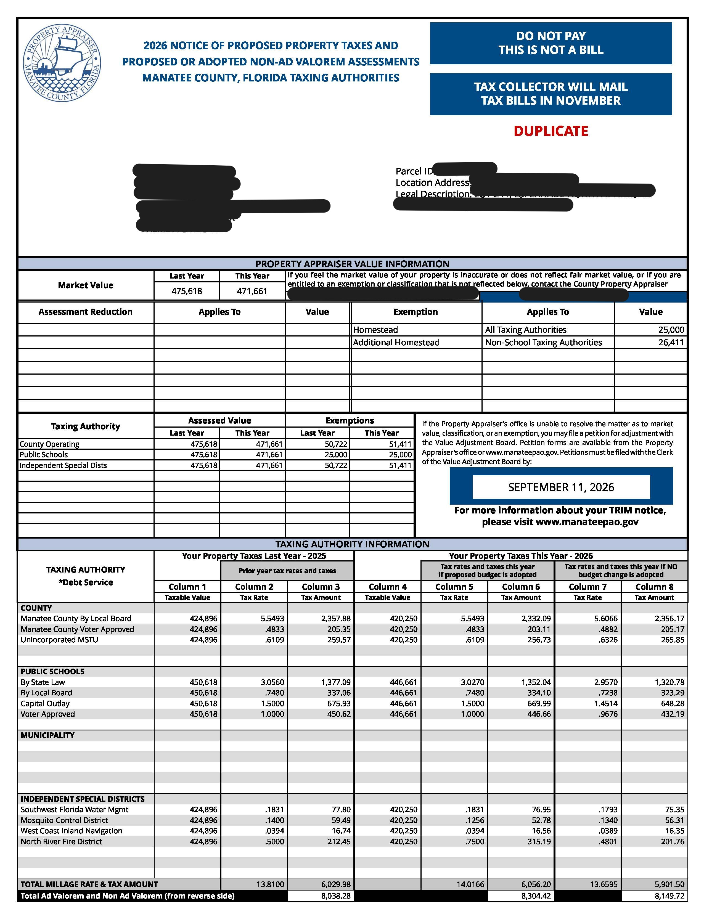
ARTISAN LAKES EAST CDD COMPARISON OF MAILED NOTICE OF ASSESSMENTS AND MANATEE COUNTY TRIM NOTICE

Slide 17
ASSESSMENT RATE AND FINAL COMMENTS
THE CAP RATE IS $439.71
NO INCREASE ABOVE THE CAP RATE WITHOUT MAILED NOTICE TO ALL PROPERY OWNERS AND A PUBLIC HEARING.
PUBLIC HEARING EVERY YEAR TO ADOPT THE BUDGET & ASSESSMENT RATES.
PUBLIC HEARING PUBLISHED ON THE WEB SITE & IN NEWSPAPER WWW.ARTISANLAKESEASTCDD.ORG THE DATE, TIME AND LOCATION.
DISTRICT WEB SITE – WWW.ARTISANLAKESEASTCDD.ORG

